Slide 1
Graph Neural Networks

Slide 2
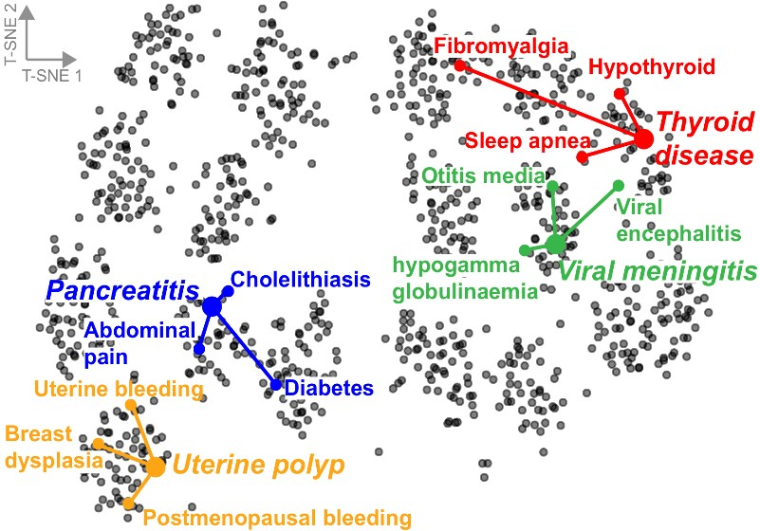
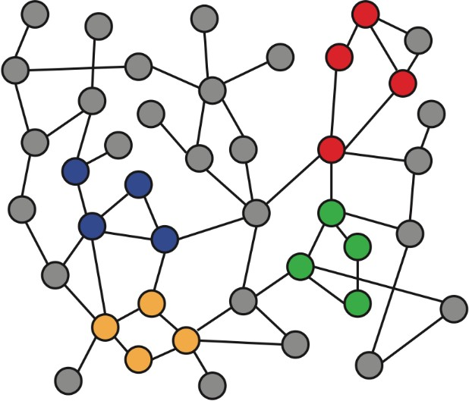
Intuition: Map nodes to 𝑑-dimensional embeddings such that similar nodes in the graph are embedded close together
f ( )=
Input graph 2D node embeddings
How to learn mapping function 𝒇?
2

Slide 3
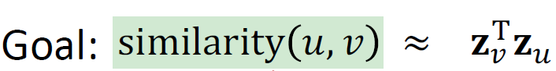
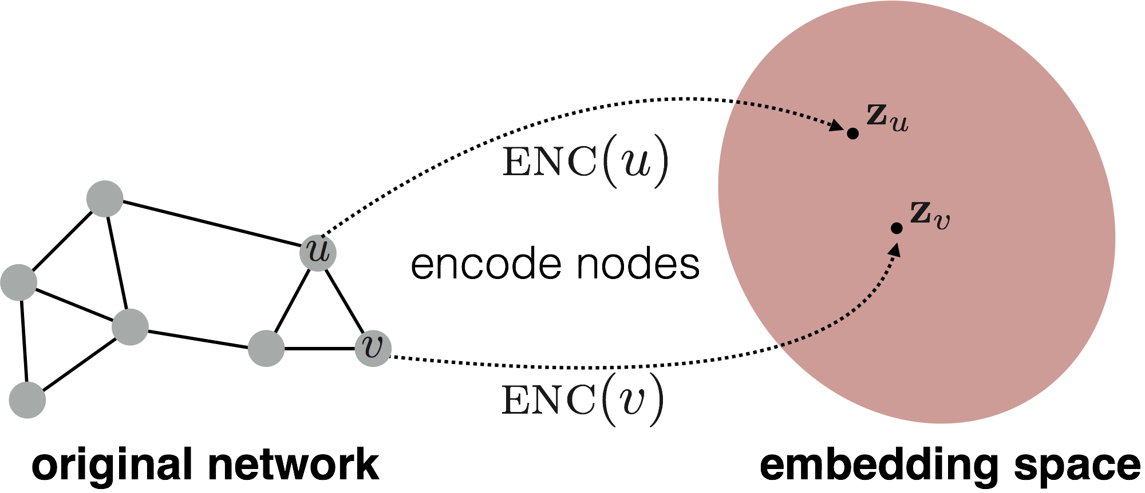
Need to define!
d-dimensional embedding space
Input network
3

Slide 4
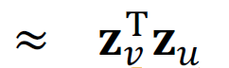
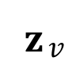
Encoder: maps each node to a low-dimensional
vector
d-dimensional embedding
ENC 𝑣 =
𝐳$v$
node in the input graph
Similarity function: specifies how the relationships in vector space map to the relationships in the original network
similarity 𝑢, 𝑣
Similarity of 𝑢 and 𝑣 in the original network
Decoder
dot product between node embeddings
4

Slide 5


Simplest encoding approach: encoder is just an embedding-lookup
embedding vector for a
embedding matrix
specific node
𝐙 =
Dimension/size of embeddings
one column per node
5

Slide 6
Limitations of shallow embedding methods:
𝑶(|𝑽|) parameters are needed:
No sharing of parameters between nodes
Every node has its own unique embedding
Inherently “transductive”:
Cannot generate embeddings for nodes that are not seen during training
Do not incorporate node features:
Many graphs have features that we can and should leverage
6

Slide 7
Today: We will now discuss deep methods based on graph neural networks (GNNs):
multiple layers of
ENC 𝑣 =
non-linear transformations based on graph structure
Note: All these deep encoders can be combined with node similarity functions defined in the previous lecture
7

Slide 8

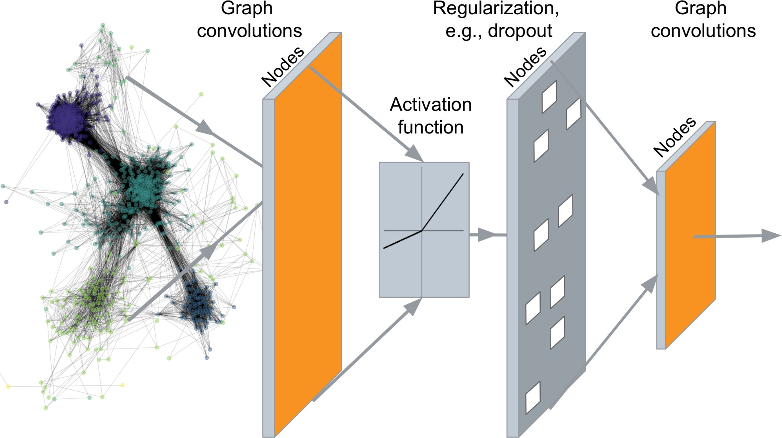
…
Output: Node embeddings. Also, we can embed subgraphs, graphs
8
Notes:
A set of node embeddings?

Slide 9
Tasks we will be able to solve:
Node classification
Predict a type of a given node
Link prediction
Predict whether two nodes are linked
Community detection
Identify densely linked clusters of nodes
Network similarity
How similar are two (sub)networks
9

Slide 10
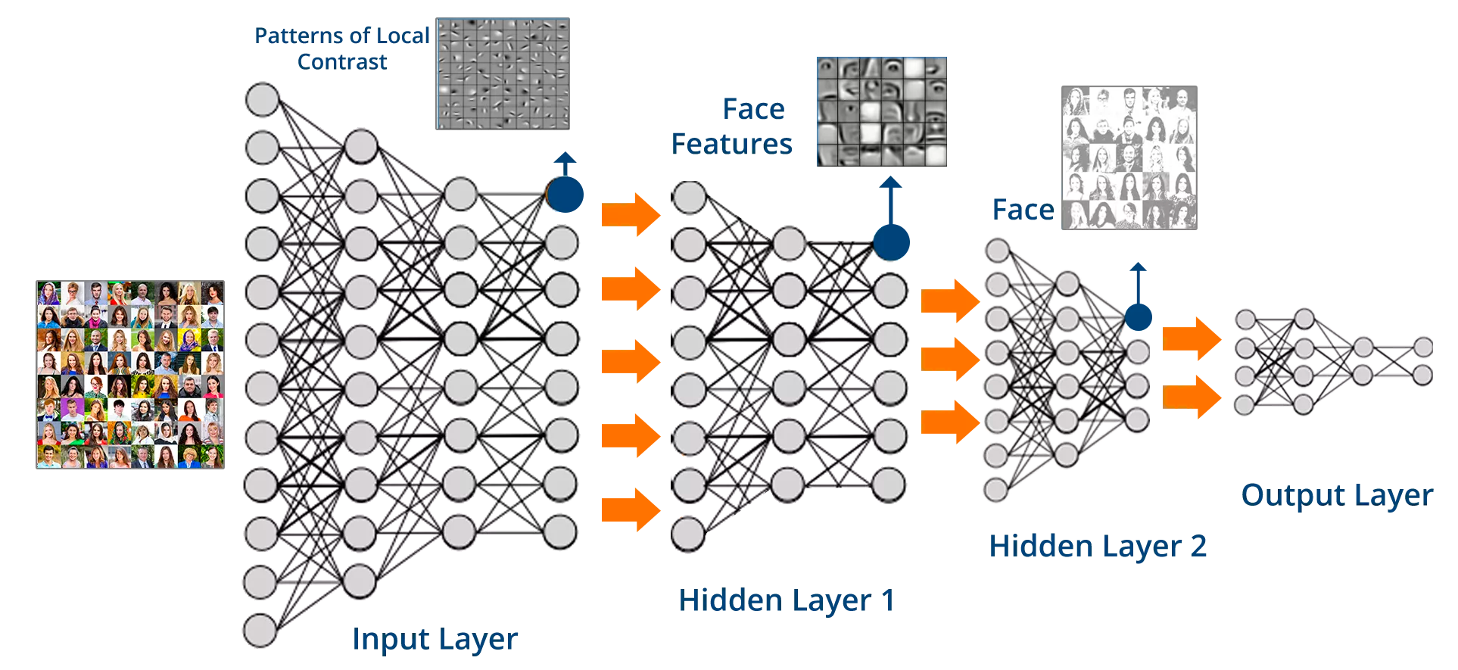
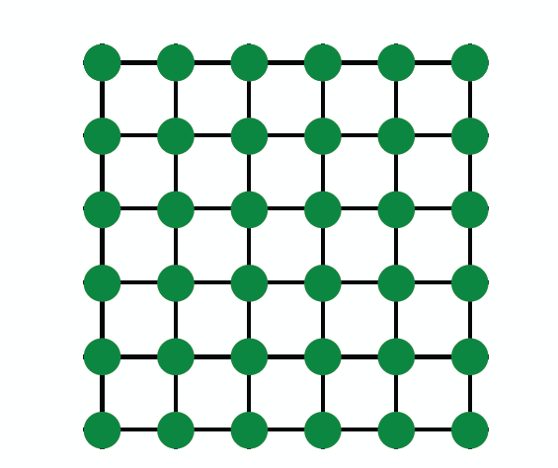
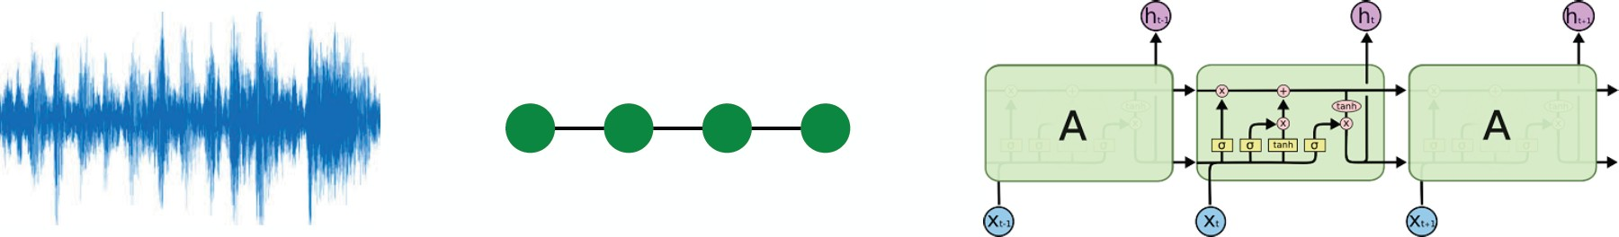
Images
Text/Speech
Modern deep learning toolbox is designed for simple sequences & grids
10

Slide 11


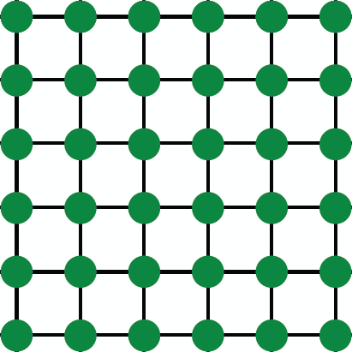

But networks are far more complex!
Arbitrary size and complex topological structure (i.e., no spatial locality like grids)
vs.
Text
Networks Images
No fixed node ordering or reference point
Often dynamic and have multimodal features
11

Slide 12

Assume we have a graph 𝑮:
𝑉 is the vertex set
𝑨 is the adjacency matrix (assume binary)
𝑿 ∈ ℝ^{:m×|V|} is a matrix of node features
𝑣: a node in 𝑉; 𝑁 𝑣 : the set of neighbors of 𝑣.
Node features:
Social networks: User profile, User image
Biological networks: Gene expression profiles, gene functional information
When there is no node feature in the graph dataset:
Indicator vectors (one-hot encoding of a node)
Vector of constant 1: [1, 1, …, 1]

Slide 13




Join adjacency matrix and features
Feed them into a deep neural net:
• Done?
A B C D E
0 1 1 1 0
1 0 0 1 1
1 0 0 1 0
1 1 1 0 1
0 1 0 1 0
Feat
A B C D E
1 0
0 0
0 1
1 1
1 0
?
A B
E
C
D
○ Issues with this idea:
Issues with this idea:
𝑂(|𝑉|) parameters
Not applicable to graphs of different sizes
▪ Sensitive to node ordering

Slide 14
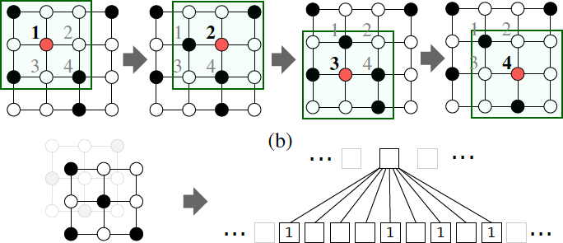

CNN on an image:
Goal is to generalize convolutions beyond simple lattices Leverage node features/attributes (e.g., text, images)

Slide 15

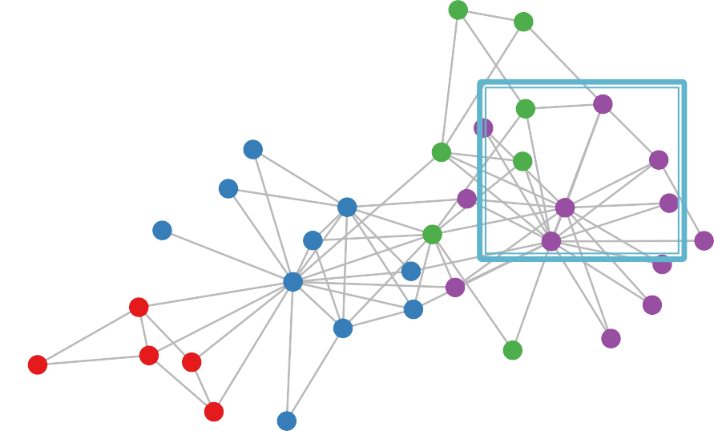






But our graphs look like this:
or this:
There is no fixed notion of locality or sliding window on the graph
Graph is permutation invariant

Slide 16
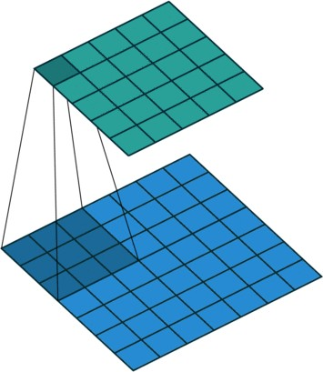
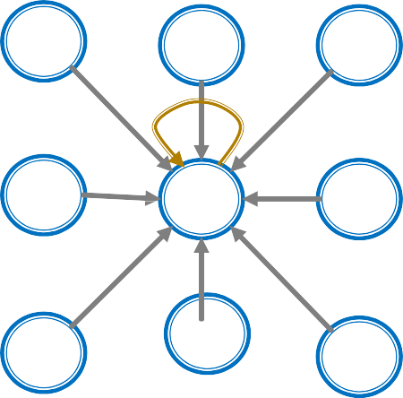
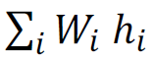
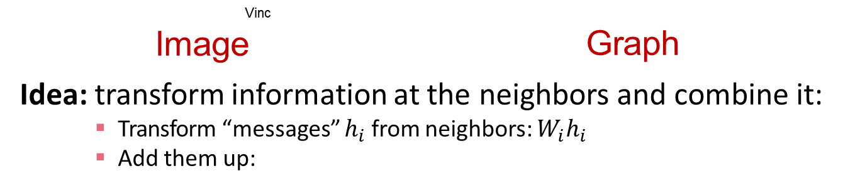
Single Convolutional neural network (CNN) layer with 3x3 filter:
(Animatio ent Dumo
Vinc
Image Graph
Idea: transform information at the neighbors and combine it:
Transform “messages” $h_{i}$from neighbors: $W_{i}h_{i}$
Add them up:

Slide 17
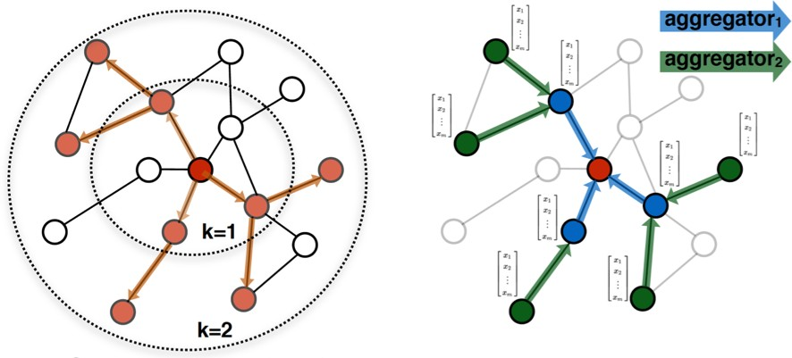


Idea: Node’s neighborhood defines a computation graph
[Kipf and Welling, ICLR 2017]
𝑖
𝑖
Determine node computation graph
Propagate and transform information
Learn how to propagate information across the graph to compute node features

Slide 18
Key idea: Generate node embeddings based on local network neighborhoods
A
TARGET NODE
B
B
C
A
B
A
C
A
C
F
E
D
F
E
D
INPUT GRAPH
A

Slide 19
Intuition: Nodes aggregate information from their neighbors using neural networks
A
TARGET NODE
B
B
C
A
B
A
C
A
C
F
E
D
F
E
D
INPUT GRAPH
A
Neural networks

Slide 20
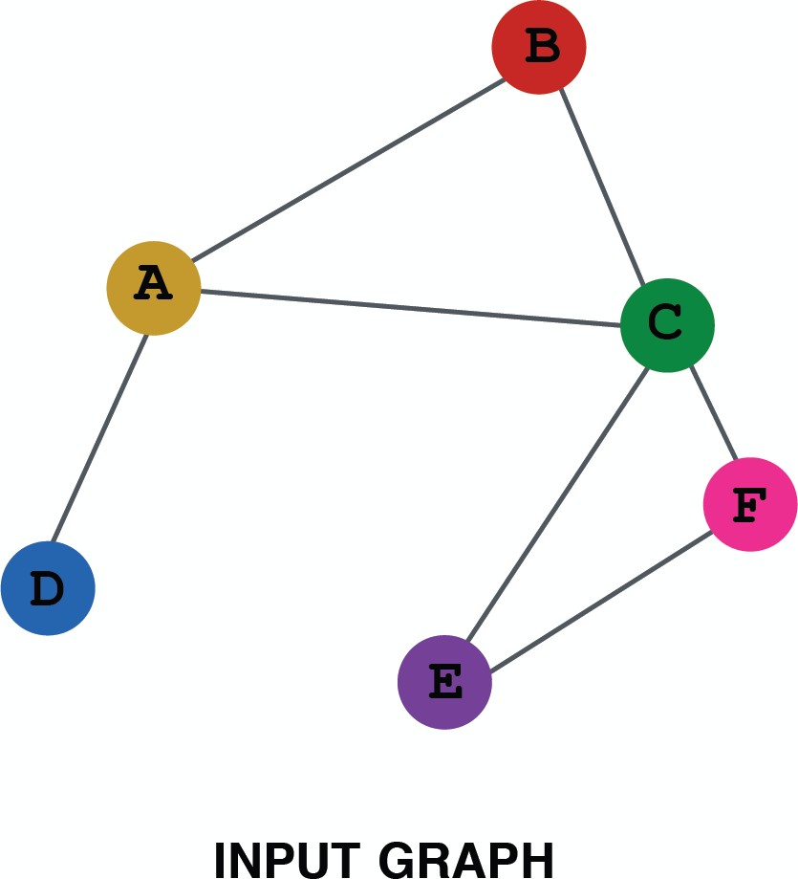
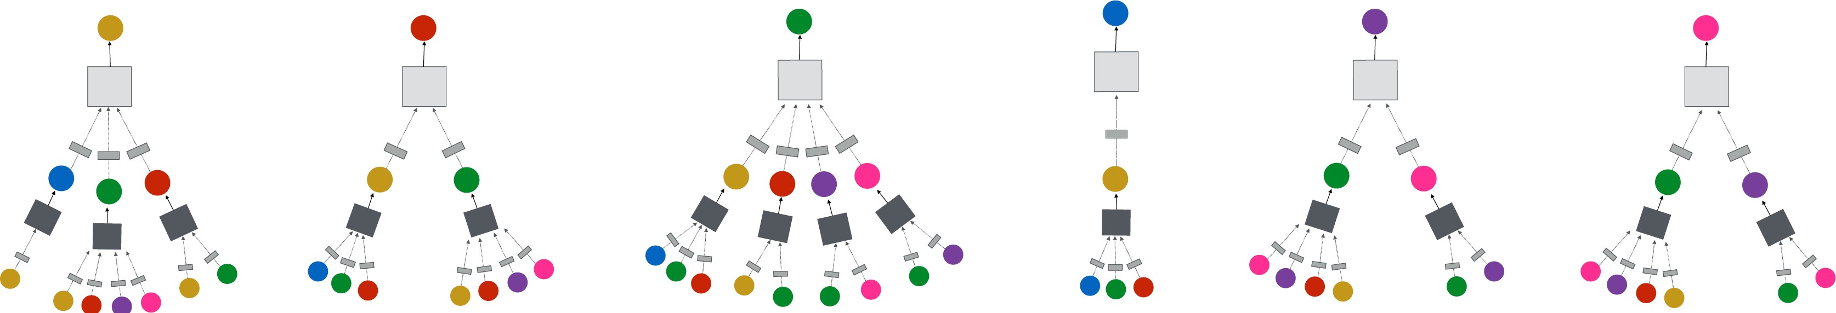
Intuition: Network neighborhood defines a computation graph
Every node defines a computation graph based on its neighborhood!

Slide 21
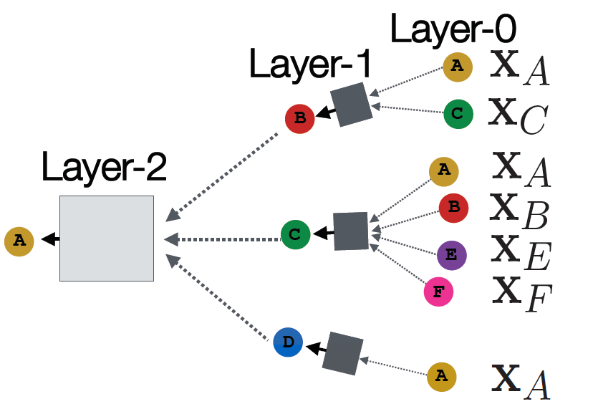






Model can be of arbitrary depth:
Nodes have embeddings at each layer
Layer-0 embedding of node 𝑢 is its input feature, 𝑥_{𝑢}
Layer-𝑘 embedding gets information from nodes that are K hops away
TARGET NODE
B
A
C
F
D
E
INPUT GRAPH

Slide 22
Neighborhood aggregation: Key distinctions are in how different approaches aggregate information across the layers
A
?
TARGET NODE
B
B
C
What is in the box?
A
A
C
B
?
?
A
C
F
E
D
F
E
D
?
INPUT GRAPH
A

Slide 23
Basic approach: Average information from neighbors and apply a neural network
(1) average messages from neighbors
A
TARGET NODE
B
B
C
A
B
A
C
A
C
F
E
D
F
E
D
INPUT GRAPH
(2) apply neural network
A

Slide 24

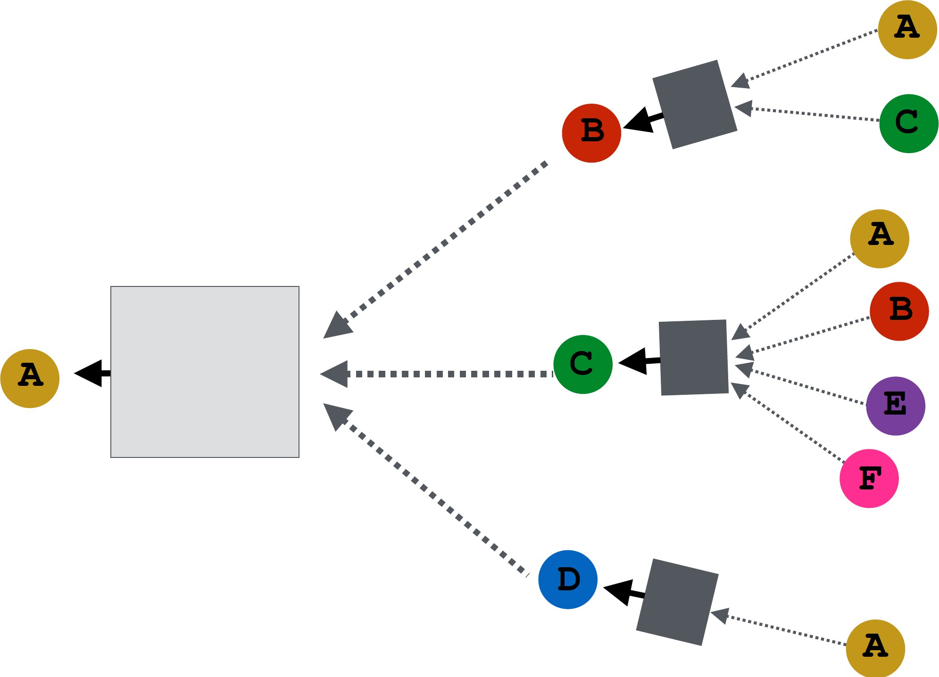
How do we train the model to generate embeddings?
𝒛_{A}
Need to define a loss function on the embeddings

Slide 25
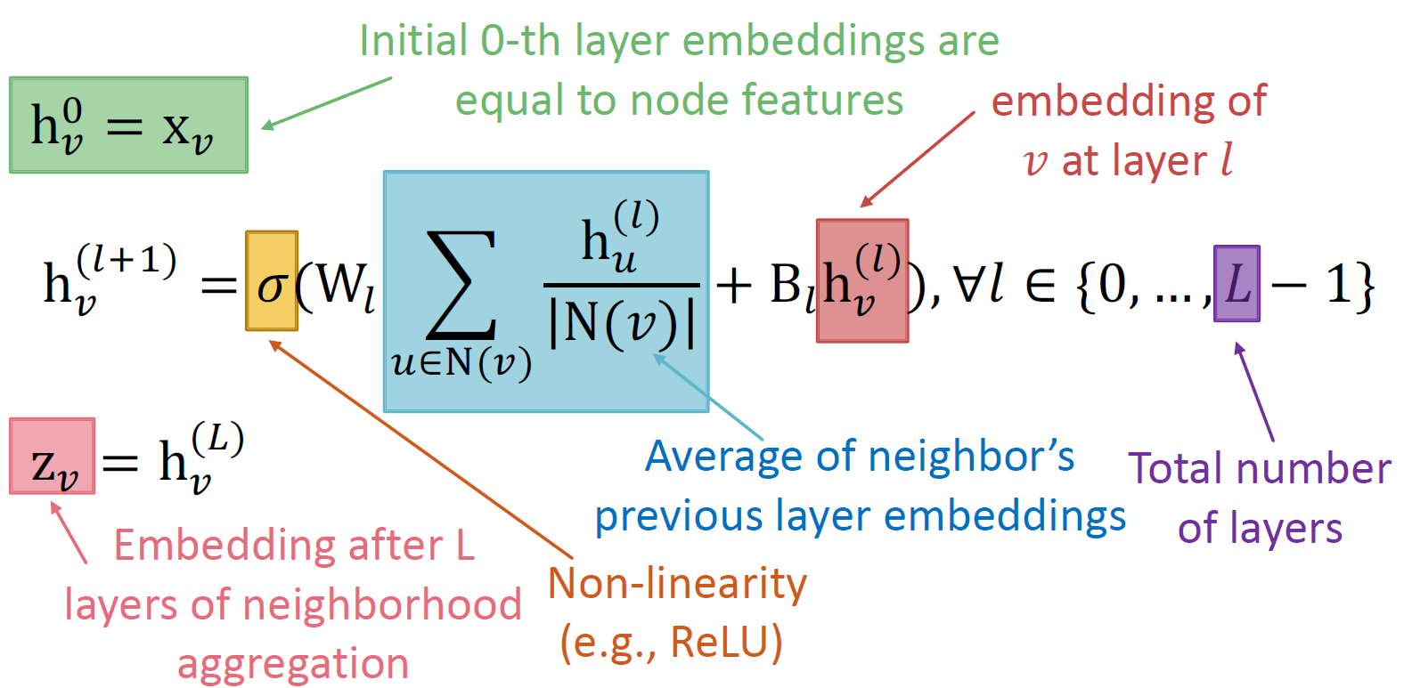

Basic approach: Average neighbor messages and apply a neural network

Slide 26
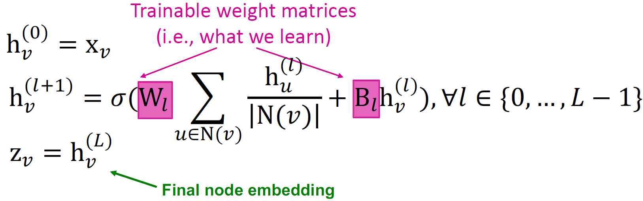
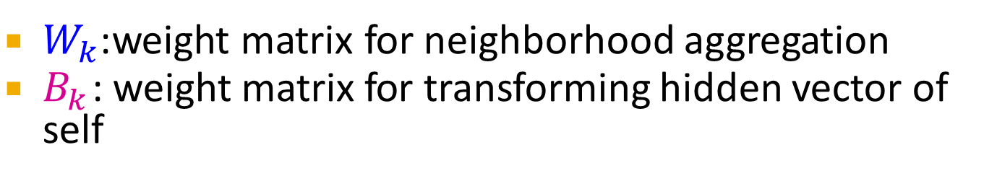
We can feed these embeddings into any loss function
and run SGD to train the weight parameters
$h_{v}^{l}$:the hidden representation of node 𝑣 at layer 𝑙
$W_{k}$:weight matrix for neighborhood aggregation
$B_{k}$ : weight matrix for transforming hidden vector of self

Slide 27
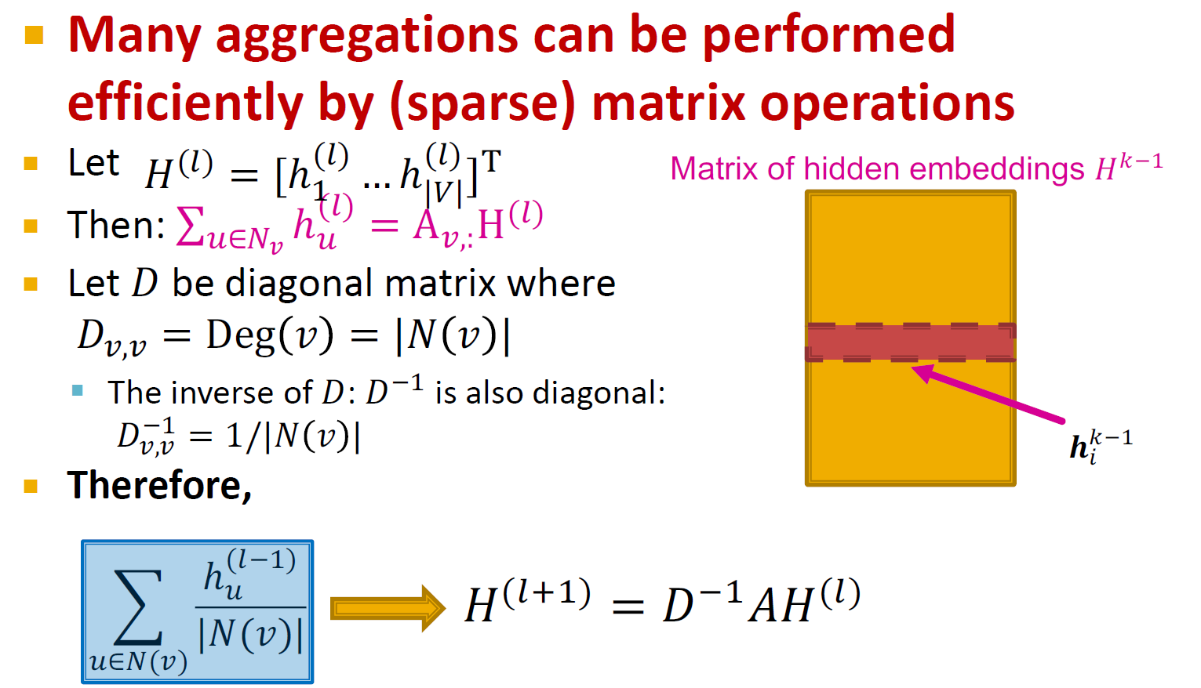

Slide 28
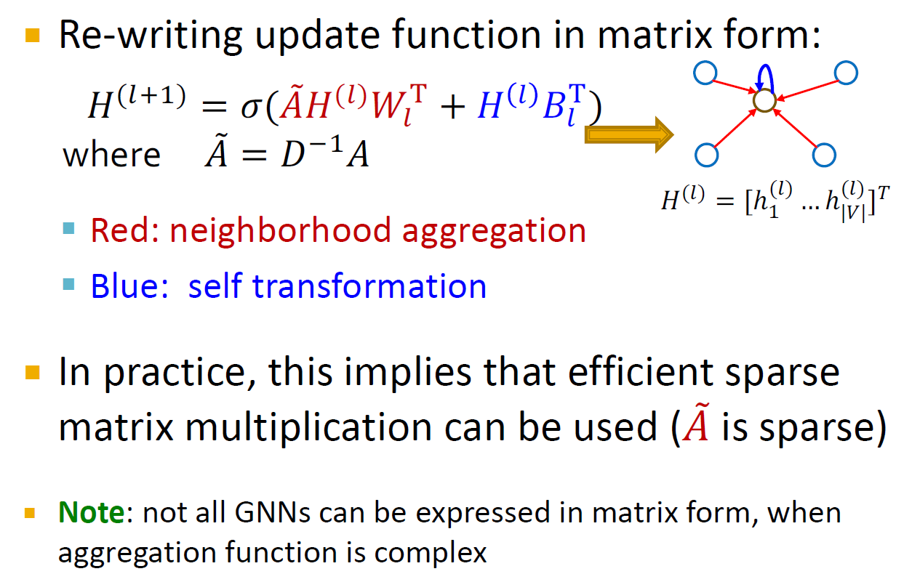
Re-writing update function in matrix form:

Slide 29
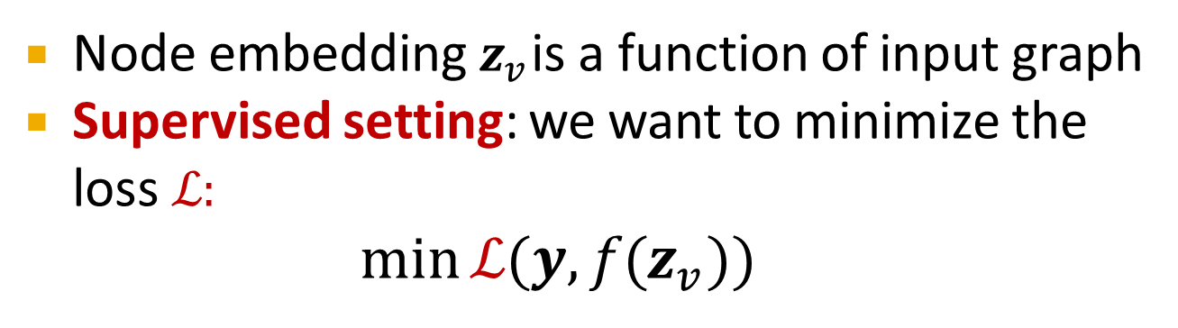
Node embedding $z_{v}$ is a function of input graph
Supervised setting: we want to minimize the loss ℒ:
min ℒ(𝒚, 𝑓$(z_{v}$ ))
Θ
𝒚: node label
ℒ could be L2 if 𝒚 is real number, or cross entropy if 𝒚 is categorical
Unsupervised setting:
No node label available
Use the graph structure as the supervision!

Slide 30

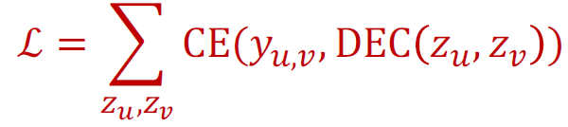
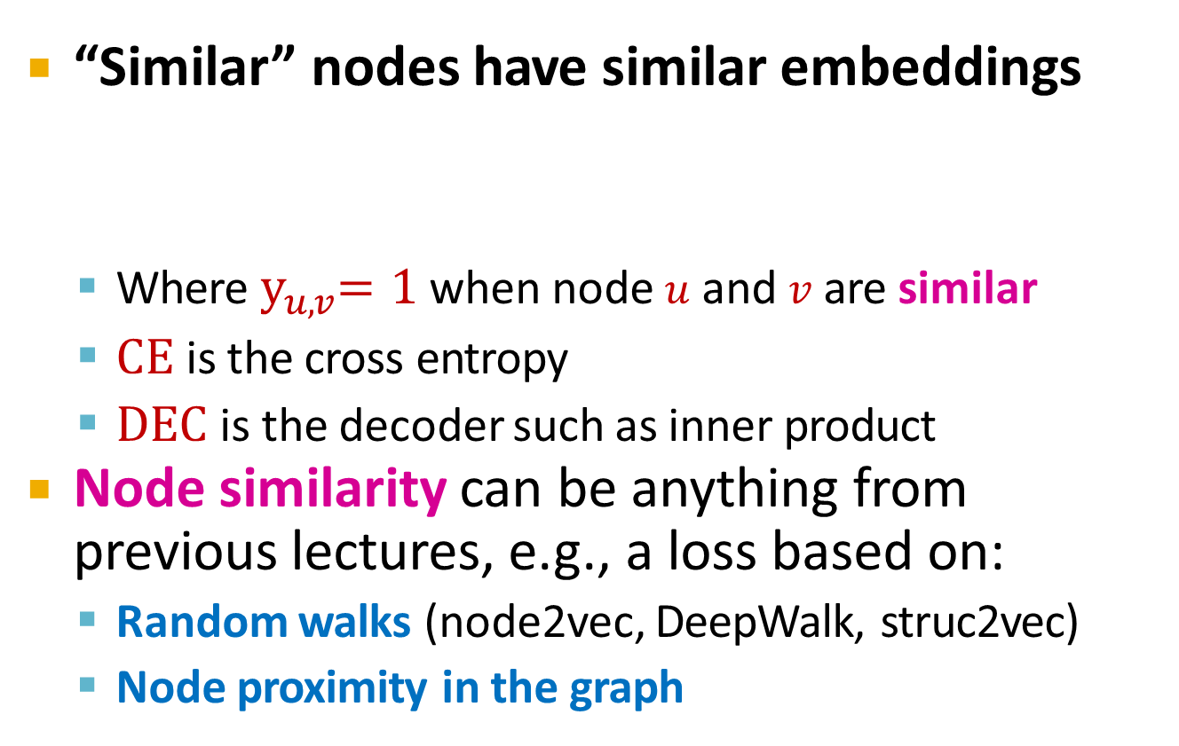
“Similar” nodes have similar embeddings
Where $y_{u,v}$= 1 when node 𝑢 and 𝑣 are similar
CE is the cross entropy
DEC is the decoder such as inner product
Node similarity can be anything from previous lectures, e.g., a loss based on:
Random walks (node2vec, DeepWalk, struc2vec)
Node proximity in the graph

Slide 31

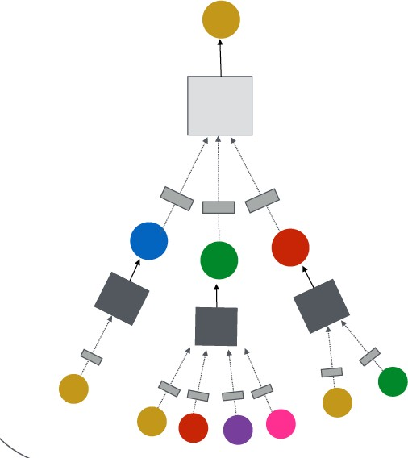
Directly train the model for a supervised task (e.g., node classification)
Safe or toxic drug?
Safe or toxic drug?
E.g., a drug-drug interaction network

Slide 32
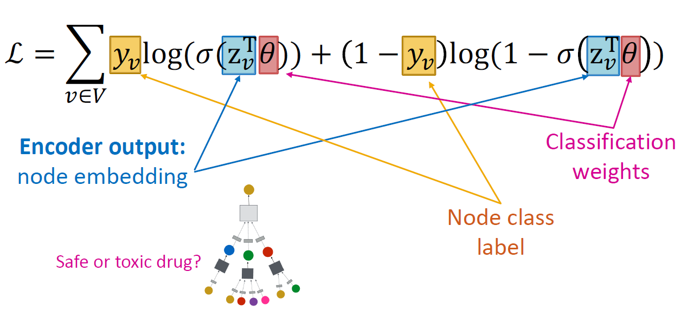
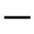
Directly train the model for a supervised task (e.g., node classification)
Use cross entropy loss

Slide 33
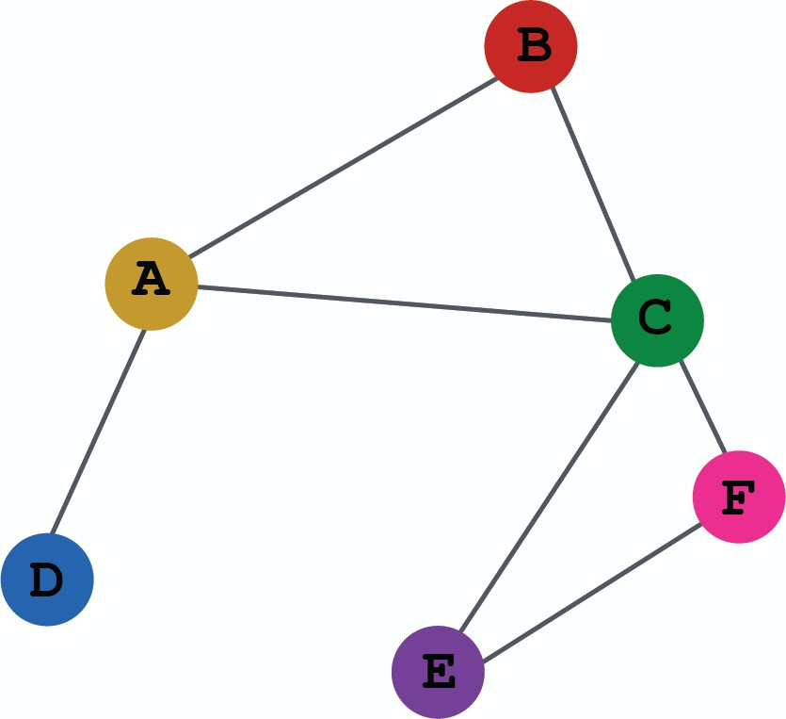
(1) Define a neighborhood aggregation function
𝒛_{A}
(2) Define a loss function on the embeddings

Slide 34
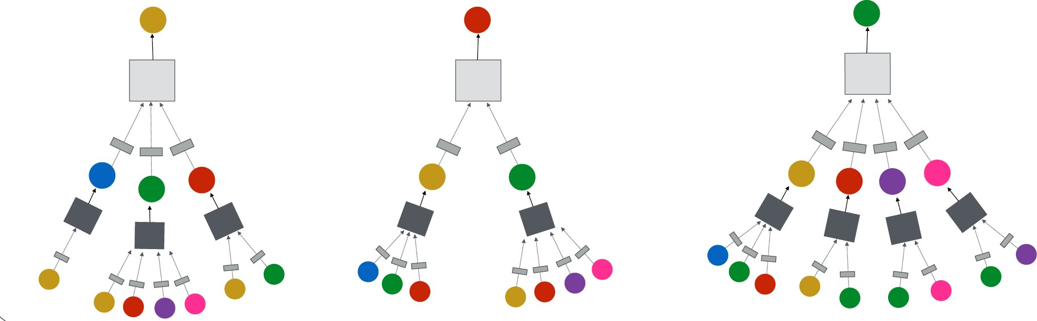
(3) Train on a set of nodes, i.e., a batch of compute graphs

Slide 35
(4) Generate embeddings for nodes as needed
Even for nodes we never trained on!

Slide 36





























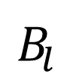
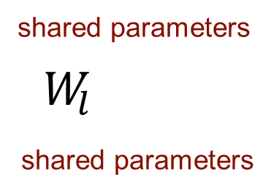
The same aggregation parameters are shared for all nodes:
The number of model parameters is sublinear in
|𝑉| and we can generalize to unseen nodes!
shared parameters
$W_{l}$
shared parameters
B
$$B_{l}$$
A
C
F
D
E
INPUT GRAPH
Compute graph for node A
Compute graph for node B

Slide 37
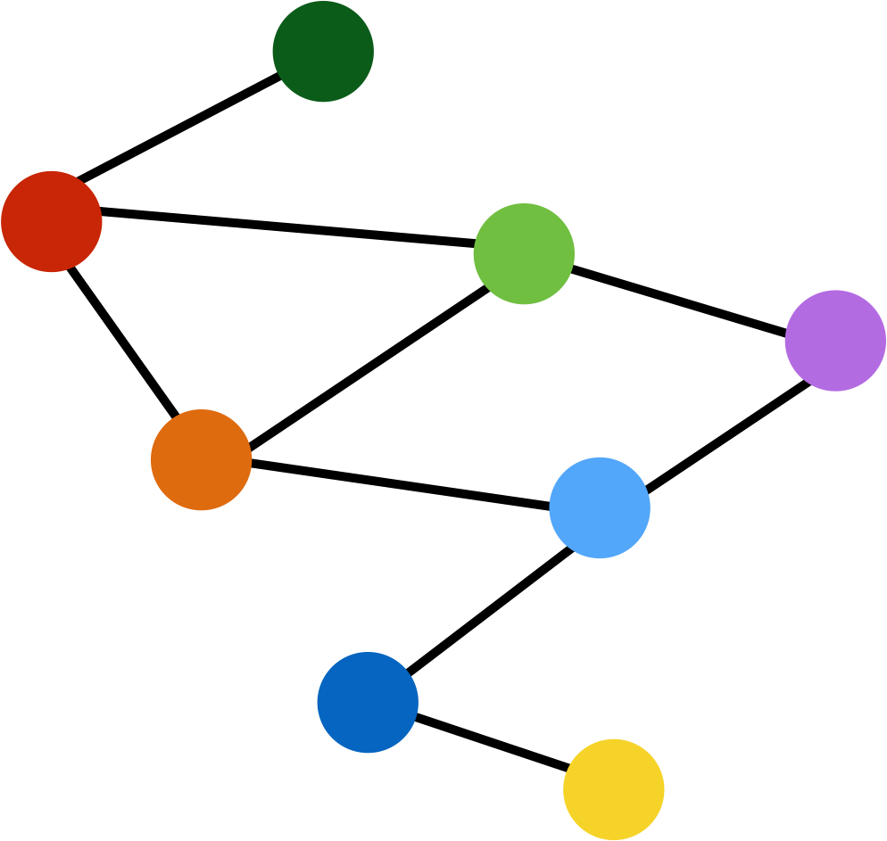
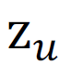
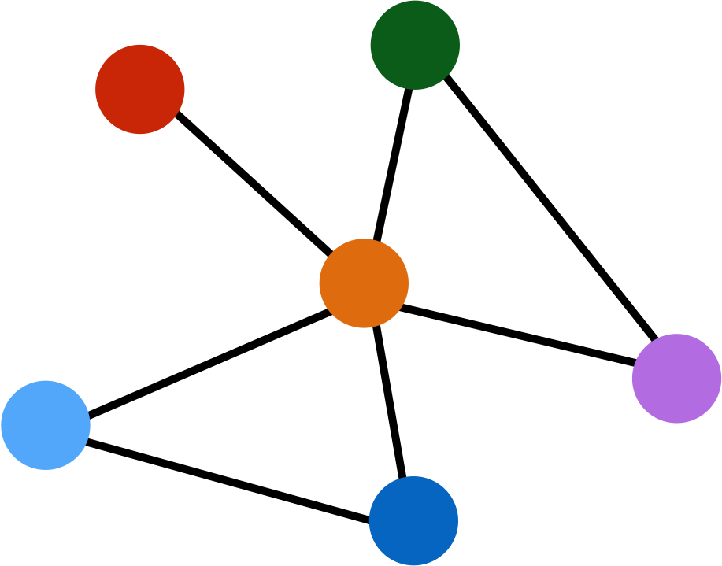
Train on one graph
Generalize to new graph
Inductive node embedding Generalize to entirely unseen graphs
E.g., train on protein interaction graph from model organism A and generate embeddings on newly collected data about organism B

Slide 38
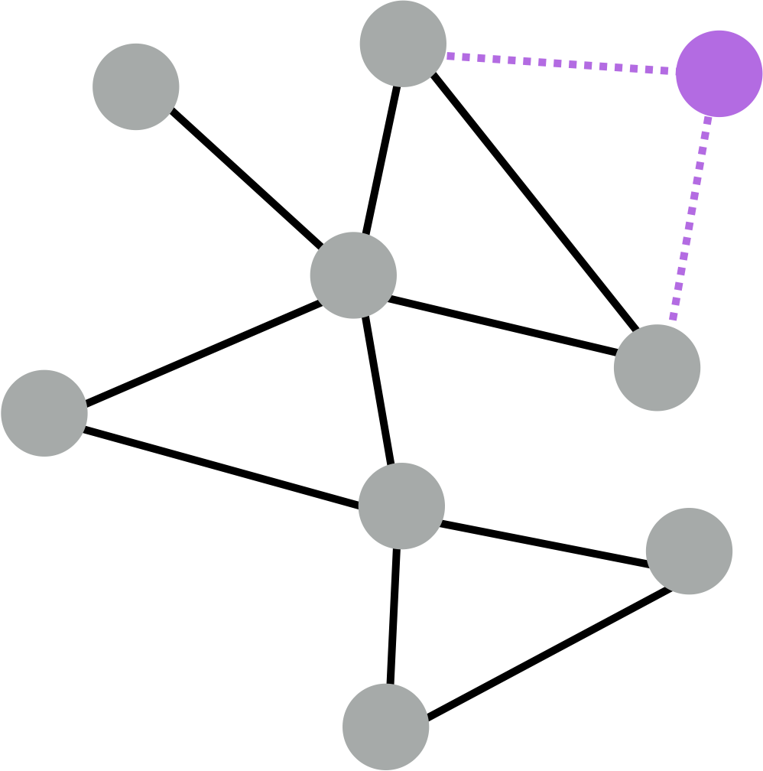
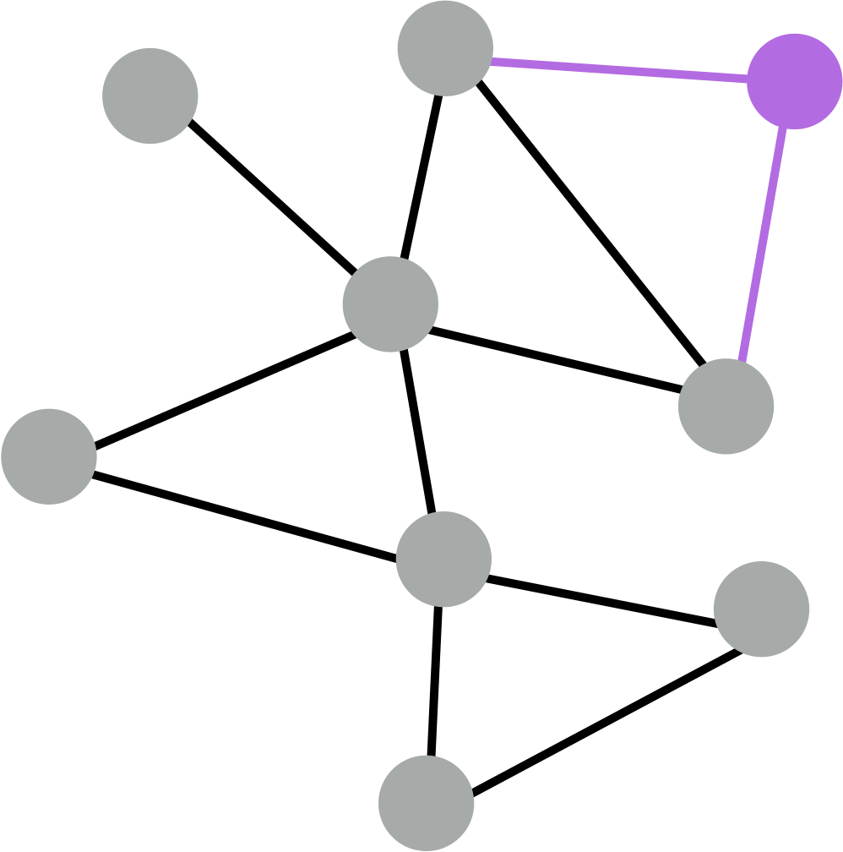
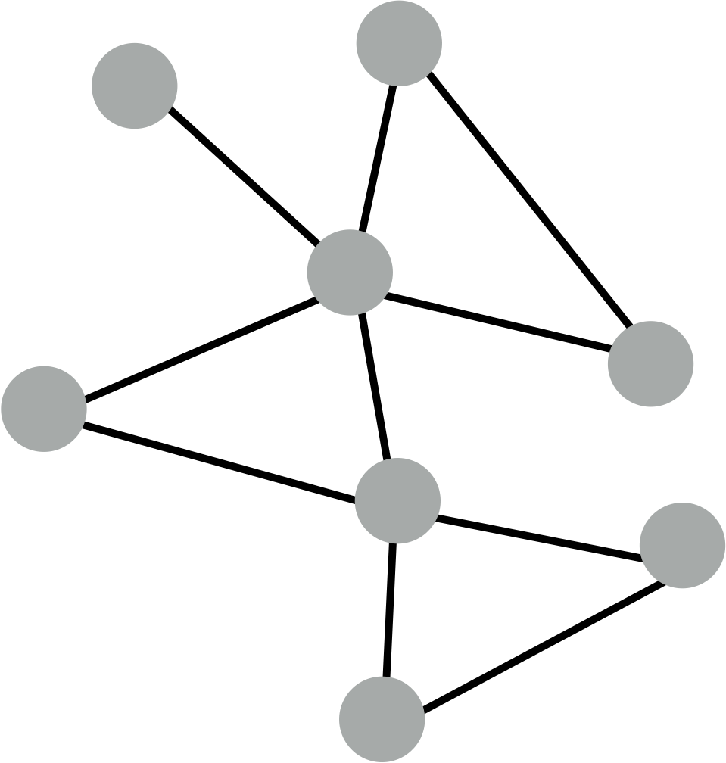
Train with snapshot
New node arrives
Generate embedding for new node
Many application settings constantly encounter previously unseen nodes:
E.g., Reddit, YouTube, Google Scholar
Need to generate new embeddings “on the fly”

Slide 39

Generate node embeddings by aggregating neighborhood information
We see a basic variant of this idea
Key distinctions are in how different approaches aggregate information across the layers

Slide 40
A General Perspective on Graph Neural Networks

Slide 41




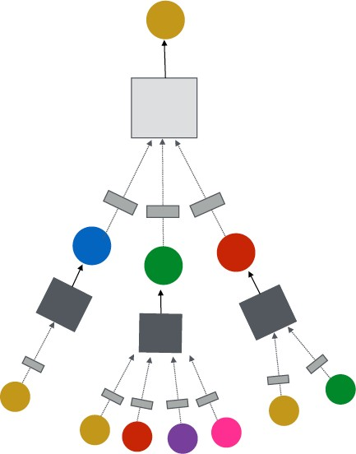


GNN Layer = Message + Aggregation
J. You, R. Ying, J. Leskovec. Design Space of Graph Neural Networks, NeurIPS 2020
TARGET NODE
B
Different instantiations under this perspective
GCN, GraphSAGE, GAT, …
A
C
D
E
F
INPUT GRAPH
(2) Aggregation
(1) Message
GNN Layer 1
41

Slide 42
Connect GNN layers into a GNN
J. You, R. Ying, J. Leskovec. Design Space of Graph Neural Networks, NeurIPS 2020
TARGET NODE
B
Stack layers sequentially
Ways of adding skip connections
A
C
D
E
F
GNN Layer 1
INPUT GRAPH
(3) Layer connectivity
GNN Layer 2
42

Slide 43
Idea: Raw input graph ≠ computational graph
J. You, R. Ying, J. Leskovec. Design Space of Graph Neural Networks, NeurIPS 2020
TARGET NODE
B
Graph feature augmentation
Graph structure augmentation
A
C
D
E
INPUT GRAPH
F
(4) Graph augmentation
43

Slide 44
J. You, R. Ying, J. Leskovec. Design Space of Graph Neural Networks, NeurIPS 2020
TARGET NODE
B
(5) Learning objective
A
C
D
E
INPUT GRAPH
F
How do we train a GNN
Supervised/Unsupervised objectives
Node/Edge/Graph level objectives
44

Slide 45
J. You, R. Ying, J. Leskovec. Design Space of Graph Neural Networks, NeurIPS 2020
TARGET NODE
B
(5) Learning objective
A
C
D
E
F
INPUT GRAPH
(2) Aggregation
(1) Message
GNN Layer 1
(3) Layer connectivity
GNN Layer 2
(4) Graph augmentation
45

Slide 46
A Single Layer of a GNN

Slide 47

GNN Layer = Message + Aggregation
J. You, R. Ying, J. Leskovec. Design Space of Graph Neural Networks, NeurIPS 2020
TARGET NODE
B
Different instantiations under this perspective
GCN, GraphSAGE, GAT, …
A
C
D
E
F
INPUT GRAPH
(2) Aggregation
(1) Message
GNN Layer 1

Slide 48

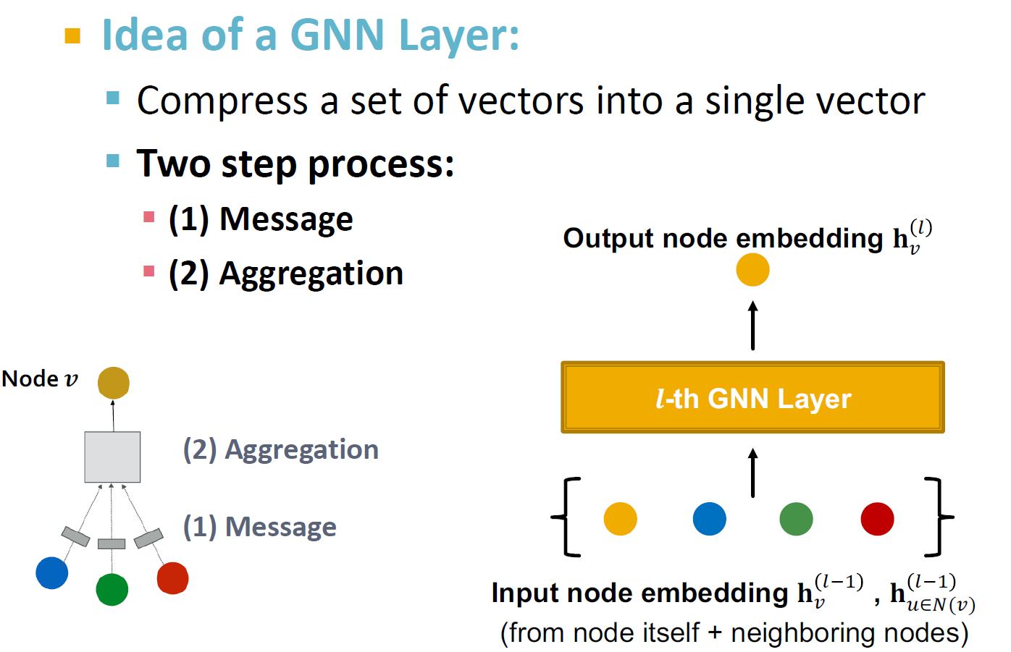

Slide 49

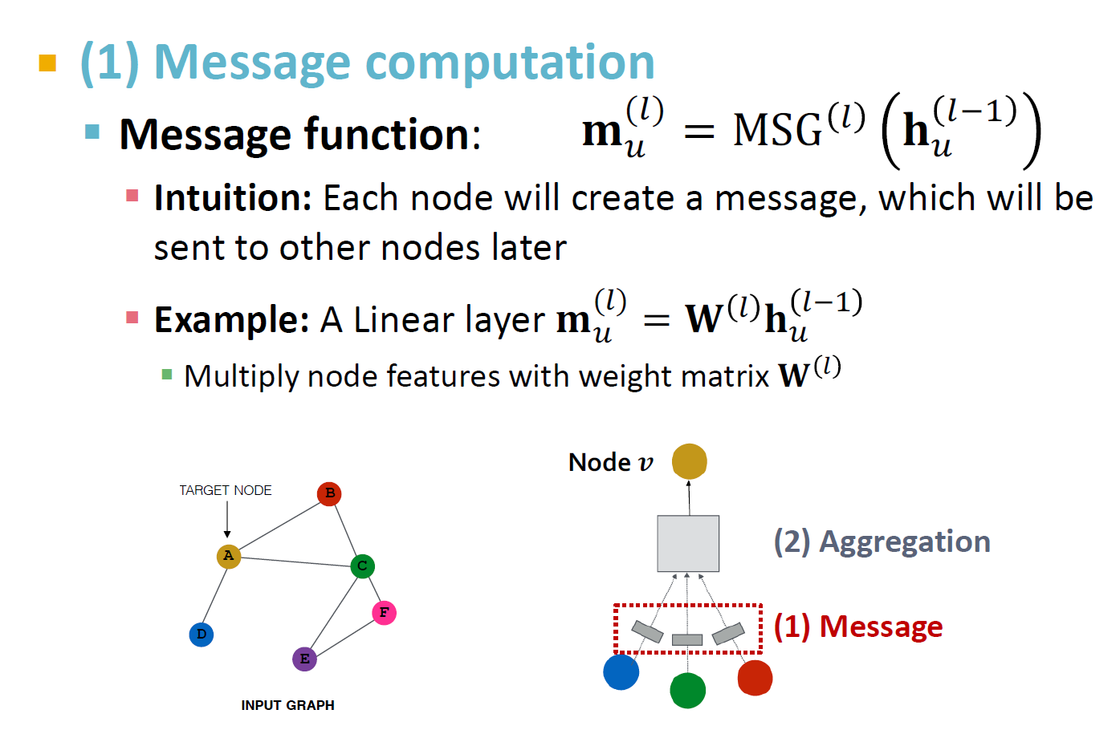

Slide 50

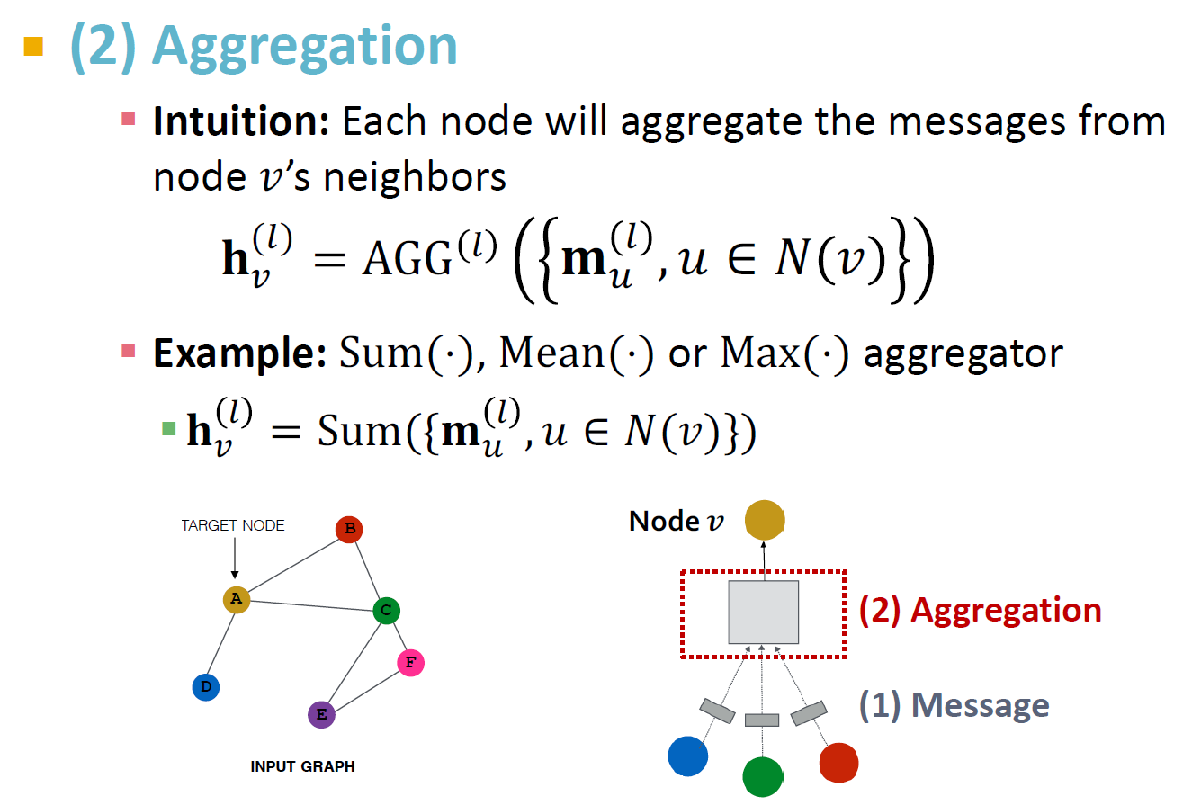

Slide 51
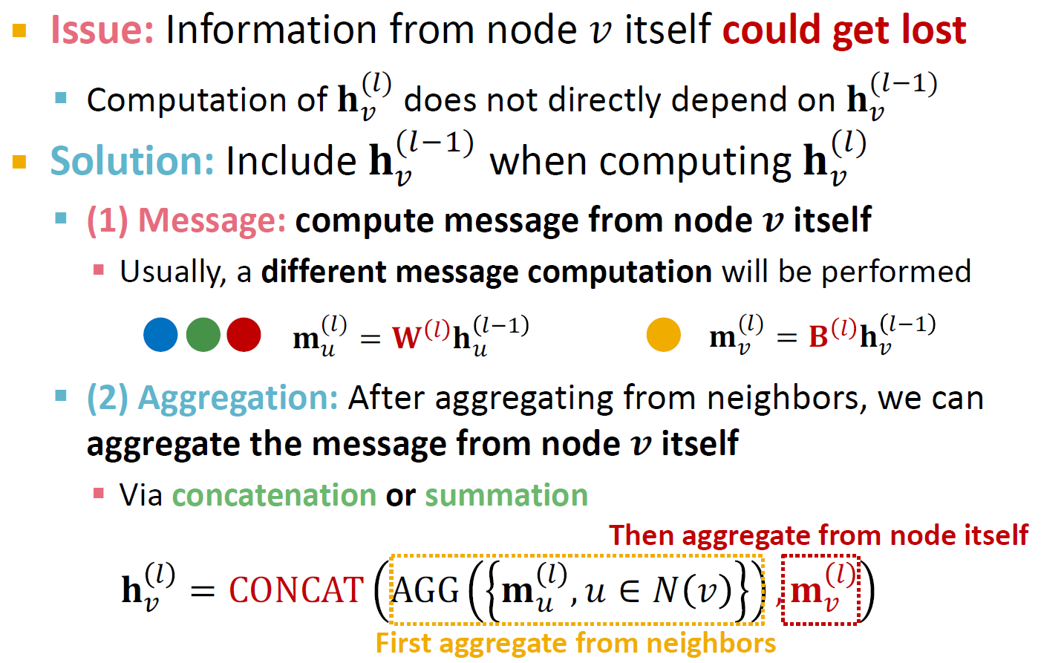

Slide 52
